Slide 1

Automatic Speech Recognition
Towards understanding deep networks
Louis ten Bosch
Radboud University Nijmegen, NL

Slide 2
ASR is a dynamic field.
Topics and techniques are changing rapidly.

Slide 3
ASR is a dynamic field.
Topics and techniques are changing rapidly.
ASR is a broad field.
We only discuss the main issues.

Slide 4
human machine interaction
language modelling
speaker recognition
speech processing
dialogue systems
text to speech
speech signal processing

Slide 5
human machine interaction
language modelling
speaker recognition
speech processing
automatic speech recognition
dialogue systems
text to speech
speech signal processing

Slide 6
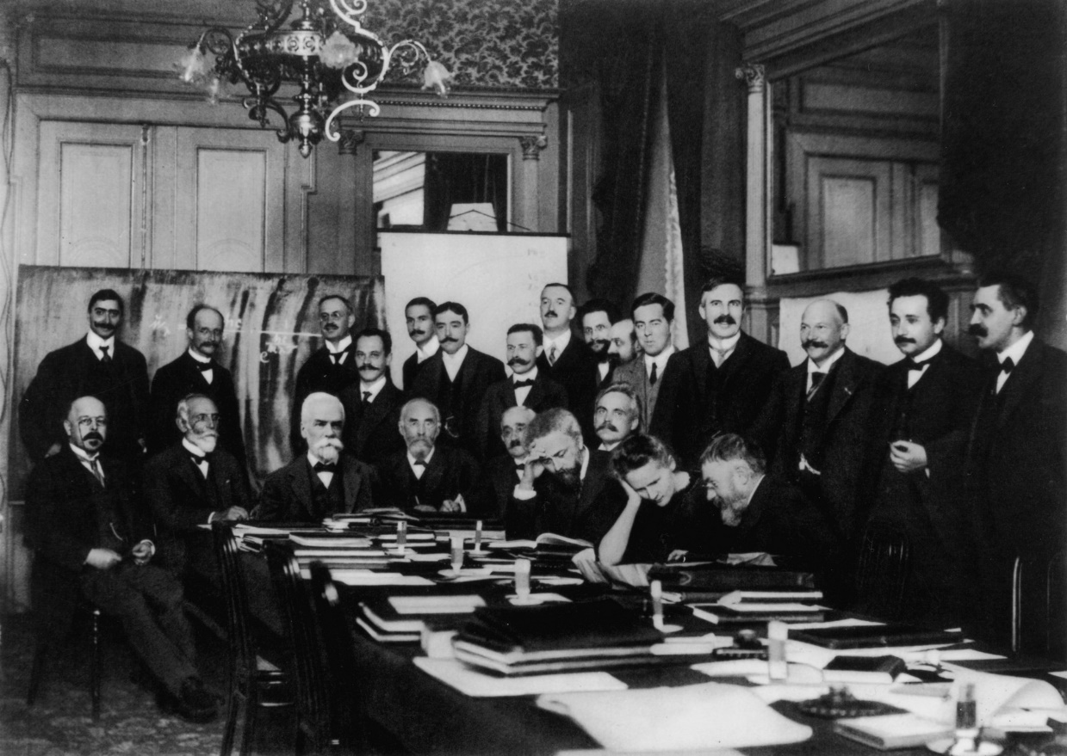

Audience?
For now:
AI
Data Science
Linguistics
…

Slide 7
You
Students: Different educational backgrounds
  Computational linguistics
  Data science
  Other
Working in groups – Real-life approach
Experiments
  You may choose your own topic/experiment (from a list)
  You may use your own database, or use a standard one from the web
Brief thesis

Slide 8
Time line of this course
intro
exp sel
experiments
thesis
round up
now mid Dec

Slide 9
Reading material
Books
  Classical ASR: Holmes & Holmes
  Jurafsky and Martin: https://web.stanford.edu/~jurafsky/slp3/
Papers: the classics (e.g., Vaswani et al., Baevski et al.)
Papers: recent
  large body of recent papers, e.g. https://www.isca-archive.org/interspeech_2025/verdini25_interspeech.html
  relevant papers will depend on your ASR experimental project
Presentation slides
  will be updated
Internet
  recent papers + videos

Slide 10
Reading material
Papers on the web, Xarxiv, etc.
Interspeech
  https://www.isca-archive.org/interspeech_2025/index.html
ICASSP
A number of key papers are given in the course
  Fastly growing
  Additional material may vary – usually depends on your experimental project

Slide 11
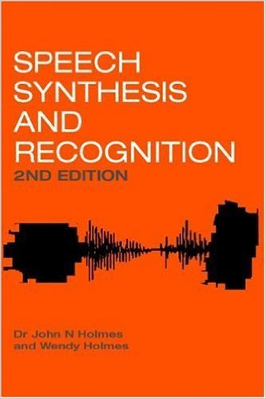
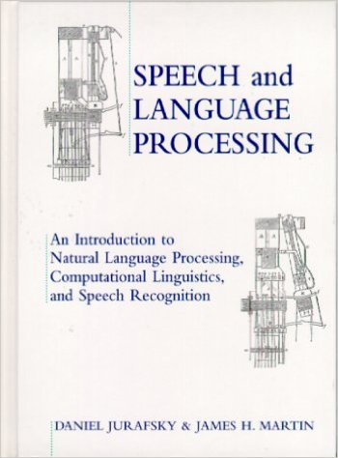
Books – the classical ones

Slide 12
Interspeech tutorial presentations
1. Tutorials - Automatic Quality Assessment for Speech and Beyond [INTERSPEECH 2025 Tutorial] Automatic Quality Assessment for Speech and Beyond
2. Nvidia NeMo toolkit for speech applications https://drive.google.com/file/d/1hlfFnVNrdHQ_FrvgVJRw4XNszl-aXVUz/view?usp=drivesdk
3. Speech Technology meets early Language acquisition: How interdisciplinary efforts benefit both the fields https://zenodo.org/records/17018214

Slide 13
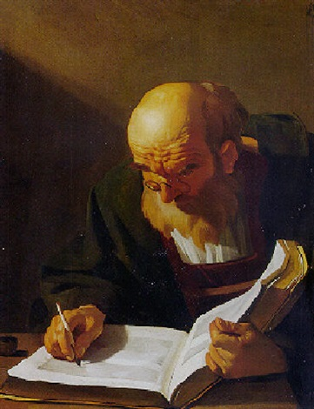
Thesis
Topic:
  ASR is way too broad to be dealt with in a few weeks
  based on experimental work
  but may also be theoretical
  will be discussed later
Experiment: individual or in a group
Writing: always individual
Assessment: individual

Slide 14
Broad overview
Week | Topic
1-2 | Lecture: Intro, overview Reading
3 | Literature, brainstorm topics for experiment
4 | Literature presentations Determine experimental topics Set-up (small) experiments
5 | Reporting ongoing experiments
6-7 | Groups of 2 or 3: 10-minute presentation Presentations of experimental results Assessment Closing

Slide 15
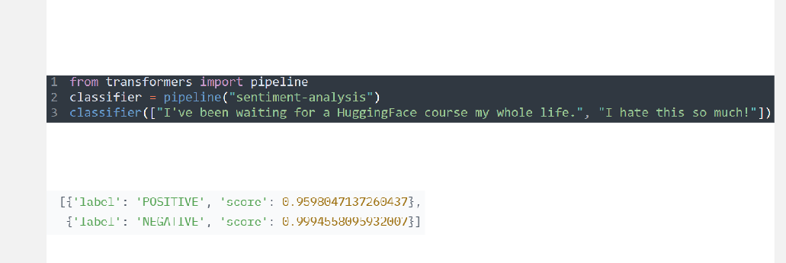
As simple as it can be

